Slide 1

web
Development FOR NEW GENERATIONS

Slide 2
Table of Contents
Frontend(creating components,pages,redux)
Introduction
01
05
Backend(starting server,create ddatabase)
Used technologies
02
06
Backend(creating models,routes)
Key Features
03
07
Backend (implementation of payment)
composition
04
08

Slide 3

Introduction
In this project, I implemented a comprehensive Ecommerce platform with key features for both admin and user interfaces. Admin functionalities included product management, order tracking, and user management, while users could browse products, add items to the cart, and securely make payments. Utilizing MongoDB for data storage, Express.js for API handling, React for dynamic user interfaces, and Node.js for server-side logic, the project provided a seamless online shopping experience for customers while offering efficient management tools for administrators.

Slide 4
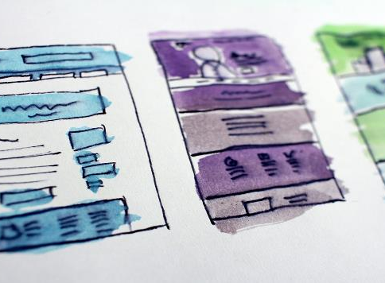



Used Technologies
React js
Describe your content here.
Express
Describe your content here.
MongoDB
Describe your content here.
I used React js for the frontend develpment, Node.js as the backend runtime for my project, Express.js for the API development process, handling routes and HTTP requests and MongoDB, as a database for data management.

Slide 5





Key features
User Features
Product Features
Admin Features
User registration
User Login/ Logout
User profile management
Order placement and tracking
Product search and filtering
Detailed single product pages
Shopping Cart fonctionality
Prodcut mangament (add,delete)
User management (add, delete)
Order managment
Payment
Responsive Design
Secure payment gateway integration(Paypal)
Chekout process
Responsive across various devices and screen sizes.

Slide 6
COMPOSITION
FRONTEND
In frontend development, I utilized React components to create modular UI elements, encapsulating specific functionalities. These components were organized into pages, combining multiple elements to form cohesive user interfaces.
BACKEND
In the backend API development, I employed Express.js, a robust Node.js framework, to create RESTful endpoints. Leveraging middleware functions, I implemented features like authentication, validation, and error handling, ensuring smooth request processing.

Slide 7

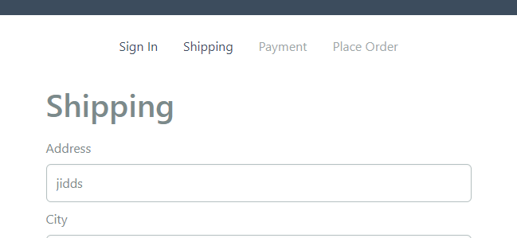
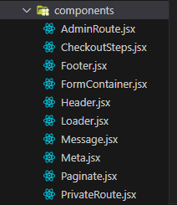

Frontend
Preparation of Components
In preparation of components, I meticulously planned the frontend architecture, defining clear and reusable React components.

Slide 8
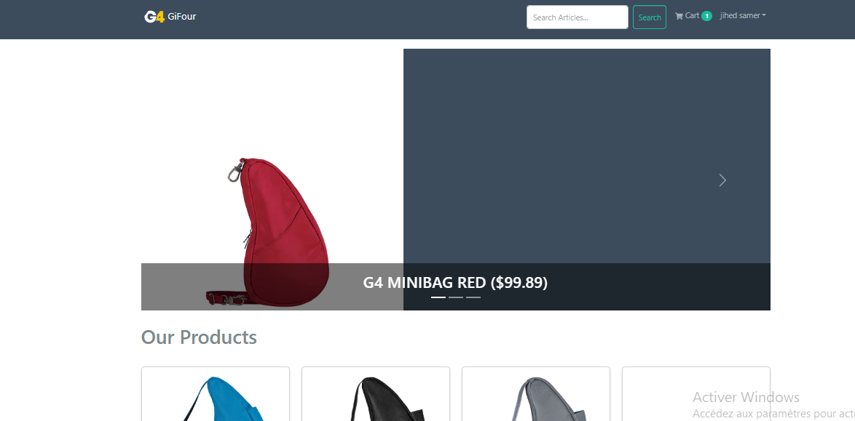

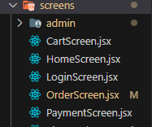
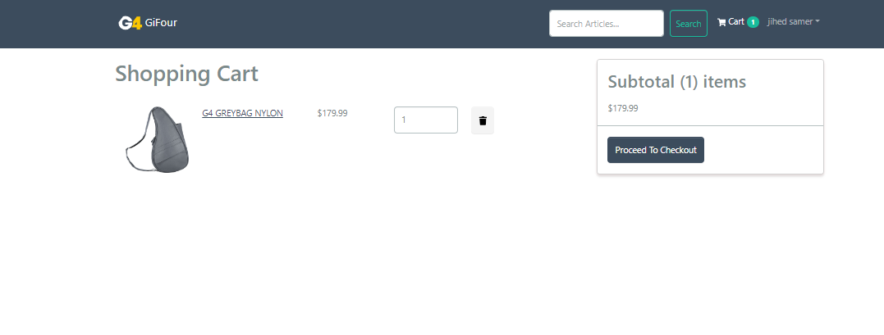
Frontend
Preparation of Pages
In preparation of pages, I carefully designed the layout and structure, focusing on user experience and intuitive navigation.

Slide 9
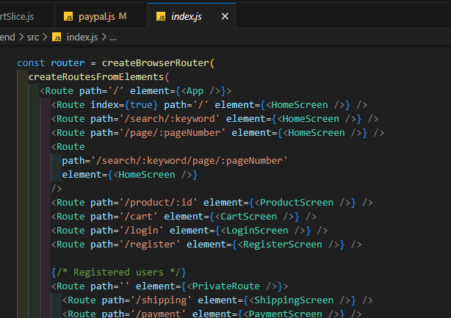

Frontend
Preparation of Routes
In preparation of routes, I strategically defined the navigation paths within the application, ensuring a logical flow between different pages and functionalities.

Slide 10

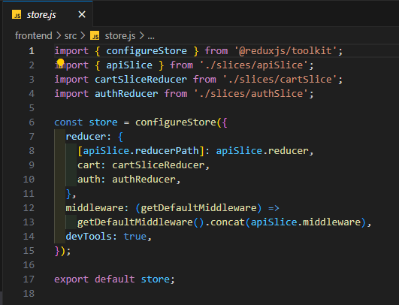
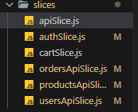
Frontend
Connect redux
In preparation of Redux, I carefully structured the global state management, defining actions, reducers, and store.

Slide 11




Backend
Starting a server
To start the server, I executed the command in the terminal, initializing the backend application. Leveraging Node.js, the server began listening to incoming requests on the port (5000).

Slide 12
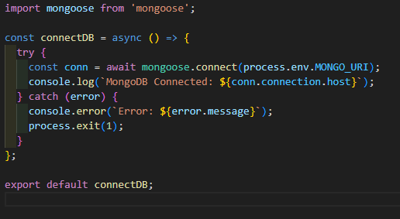


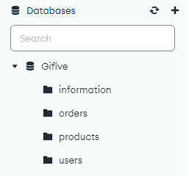
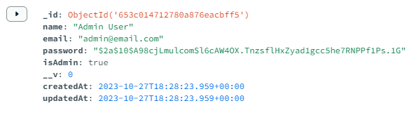

Backend
Connect DataBase (MongoDB)
To connect to MongoDB, I utilized Mongoose, a MongoDB object modeling library for Node.js. Using the provided MongoDB URI and Mongoose's connect method.

Slide 13
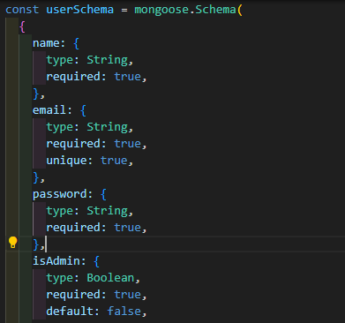


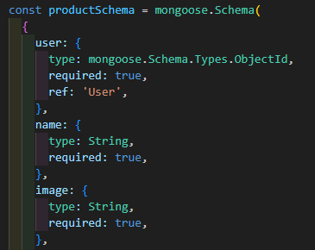
Backend
Creating
models
In creating models, I defined the data structure for MongoDB documents using Mongoose schema. By specifying fields, data types, and validation rules, I ensured consistent data storage.

Slide 14
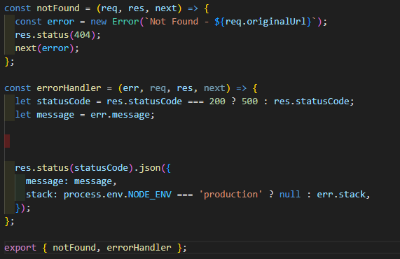

Backend
Creating
Middlewares
Incorporating middlewares, I enhanced request handling by intercepting HTTP requests before reaching the route handlers. These functions facilitated tasks like authentication, input validation, and error handling.

Slide 15
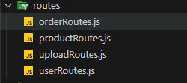


Backend
Create Controllers & Routes
I designed the controllers that will be integrated into routes, where I mapped http methods to the corresponding controller functions, enabling seamless endpoint access. This approach enhanced maintainability and allowed for efficient scaling of the application's backend functionality.

Slide 16
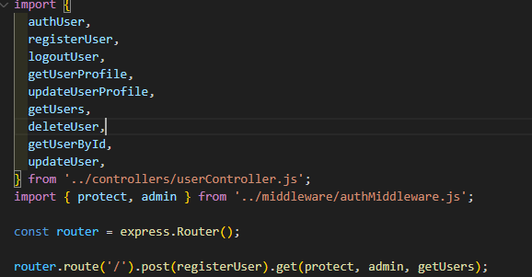
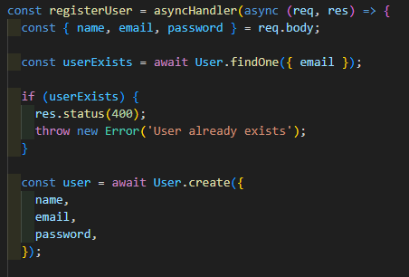


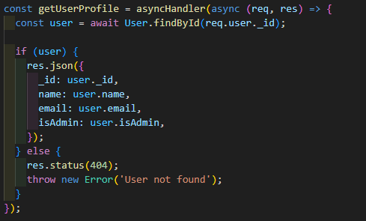

Backend
Register API
User Profile API

Slide 17
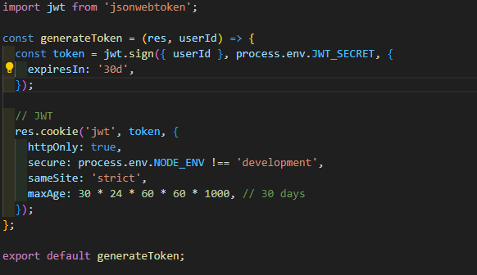

Backend
JWT
With integrating JWT I implemented secure user authentication and authorization processes. By generating and validating tokens, I ensured data confidentiality and user identity verification.

Slide 18
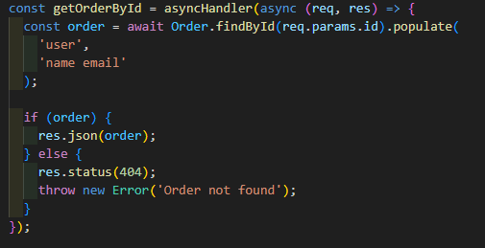
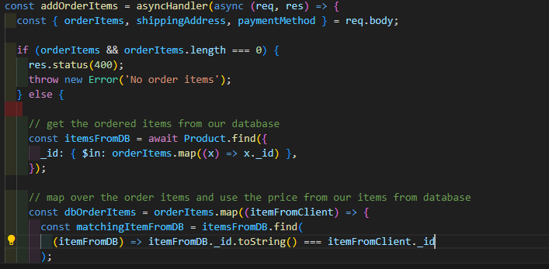


Backend
Order creation
Retrieve an Order
Orders

Slide 19

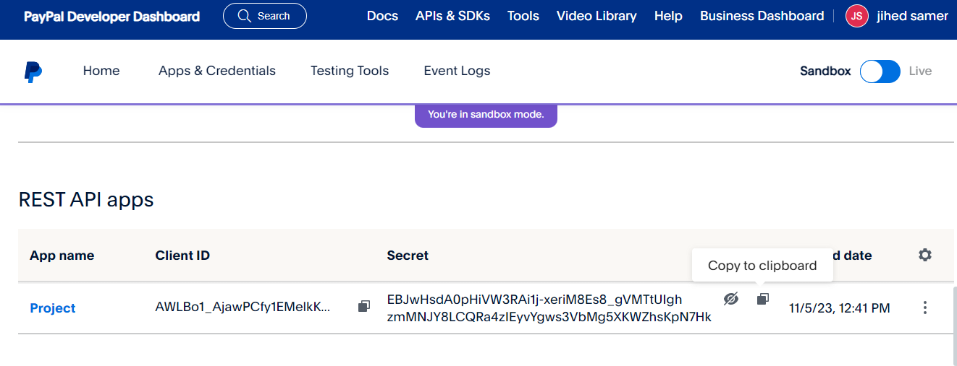


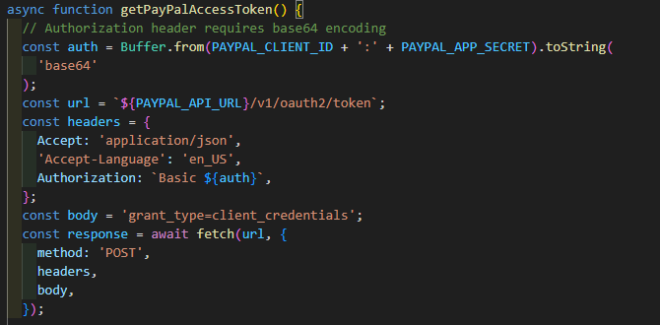
PayPal Configuration
Create PayPal Sandbox Account
Payment

Slide 20
THANKS FOR YOUR TIME

